Slide 1
Flutter 101
Youssef Altherwy
Dhekra Ben Sassi

Slide 2
Structure (Main folders and files)
.idea folder (special for android studio – not important)
Android/iOS folder (important, will build the android app. Usually not changed by User).
Build folder (important, output of Flutter app, managed by flutter SDK, rarely changed by user until the deployment at the end)
Lib folder(The most important during development , holds .dart files )
Test folder (Writing test functions , not important during early development)
pubspec.yaml file ( manage packages, such as third-party packages, and assets. Really important)

Slide 3
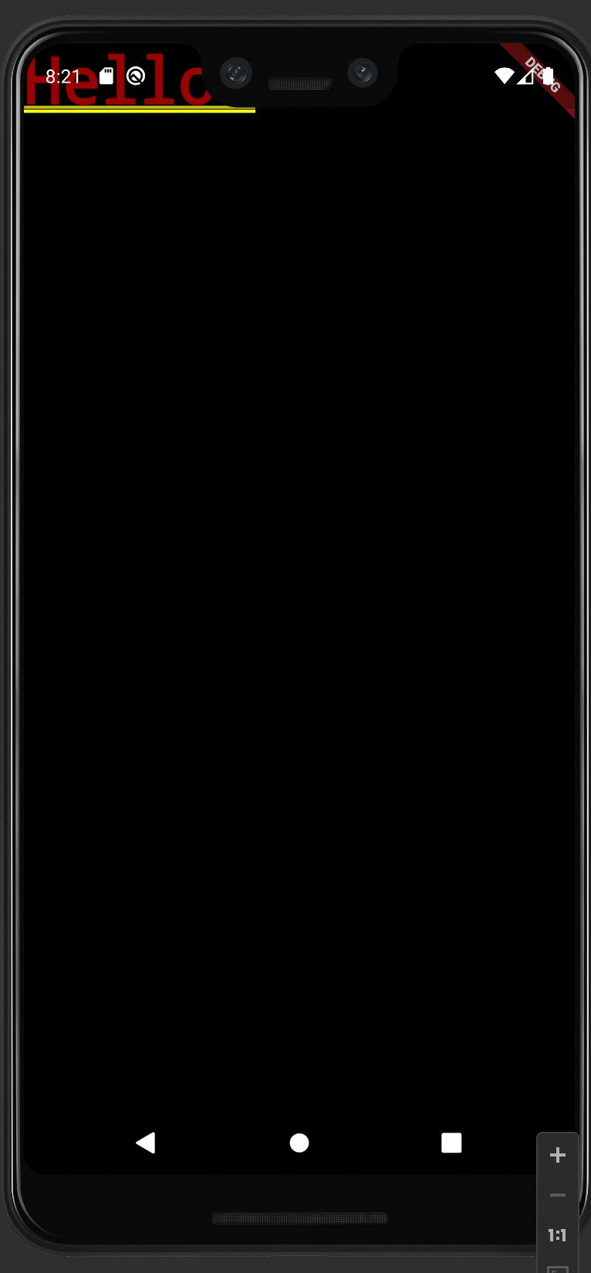
import 'package:flutter/material.dart'; // material is Google's design system and its part of the flutter SDK void main(){ runApp(MyApp()); // a method in material.dart, which runs the App. It calls the build method // MyApp is the core Widget in this app. () are required! } class MyApp extends StatelessWidget{ // MyApp is a custom Widget based on StatelessWidget @override Widget build(BuildContext context) { // build is a method to build a Widget, it's part of the SuperClass (StatelessWidget) // BuildContext is a locator that locates each Widget and its position on the Widget Tree. return MaterialApp(home: Text('Hello!'),); // Google's Design System } }

Slide 4
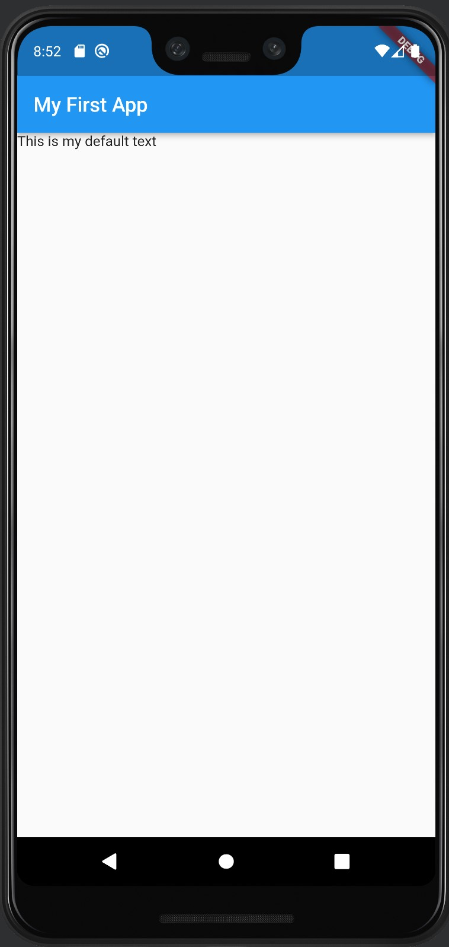
import 'package:flutter/material.dart'; void main() => runApp(MyApp()); class MyApp extends StatelessWidget { @override Widget build(BuildContext context) { return MaterialApp( home: Scaffold( appBar: AppBar( title: Text('My First App'), ), body: Text('This is my default text')), ); /* - Scaffold create a base design of the page - appBar is the Bar usually at the top of a page - AppBar is a Material Widget that creates the standard Bar for apps - body is the body of a page */ } }

Slide 5
Different Types of Widgets
Widget
Invisible
Visible
Row(), ListView()
Text(), Card()
Container
Container

Slide 6
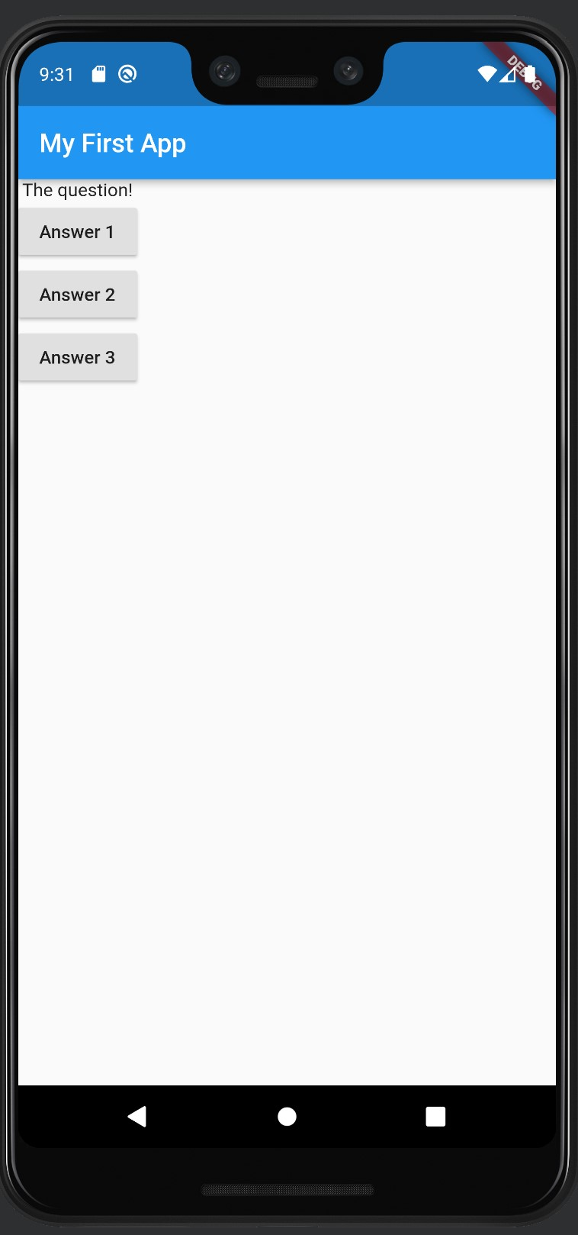
import 'package:flutter/material.dart'; void main() => runApp(MyApp()); class MyApp extends StatelessWidget { void answerQuestion(){ print('Answer Chosen!'); } @override Widget build(BuildContext context) { return MaterialApp( home: Scaffold( appBar: AppBar( title: Text('My First App'), ), body: Column( // Invisible Widget, could contains widgets (as a list inside children:) organized below each other children: [ // Text('The question!'), RaisedButton(child: Text('Answer 1'),onPressed: answerQuestion,), RaisedButton(child: Text('Answer 2'),onPressed: answerQuestion,), // RaisedButton(child: Text('Answer 3'),onPressed: answerQuestion,), ], )), ); /* - RaisedButton is deprecated but can be used (replaced by ElevatedButton) - onPressed is called when the Button is clicked - onPressed accepts a function that returns nothing and has no arguments (() -> void) - To pass a function to onPressed, you should omit () */}}

Slide 7
Understanding “State”
In General
State is Data/Information used by your App
App State
Authenticated Users
….
Widget State
Current User Input
is a loading Spinner is shown
…

Slide 8
Stateless vs. Stateful
Input Data
Date can change (only externally)
Input Data
Date can change (externally)
Widge
Widget (Internal State)
Renders UI
Rendered when input data change
Renders UI
Rendered when input data change or local State changes

Slide 9
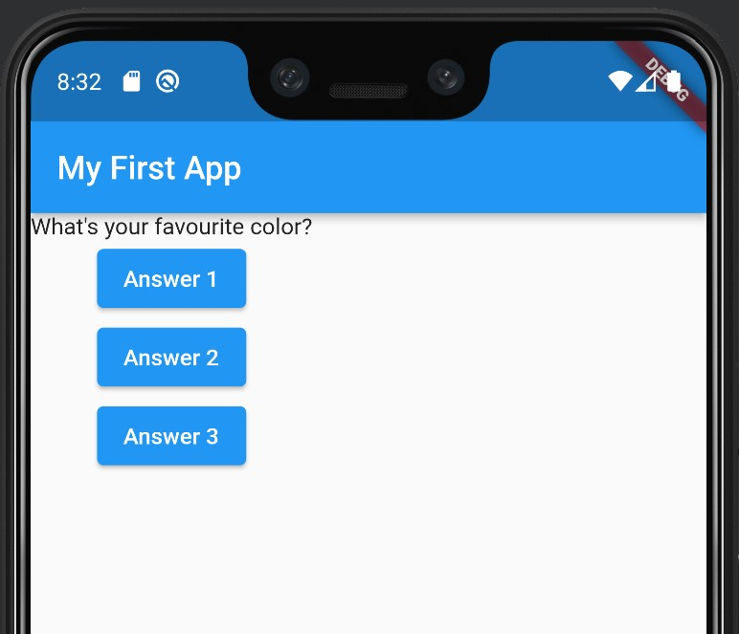
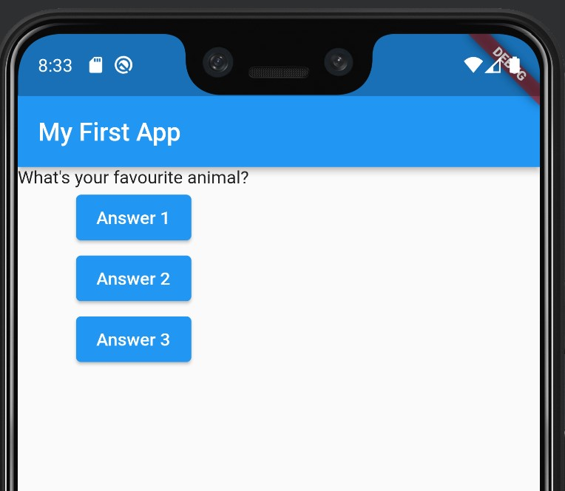
import 'package:flutter/material.dart'; void main() => runApp(MyApp()); class MyApp extends StatefulWidget { @override State<StatefulWidget> createState() { return MyAppState(); // link MyApp to MyAppState } } class MyAppState extends State<MyApp>{ // <MyApp> link this class to the MyApp class var questionIndex = 0; void answerQuestion() { setState(()=> questionIndex = questionIndex + 1); // important to implement setState method, accepts function as argument and returns nothing } @override Widget build(BuildContext context) { var questions = [ 'What\'s your favourite color?', 'What\'s your favourite animal?' ]; return MaterialApp( home: Scaffold( appBar: AppBar( title: Text('My First App'), ), body: Column( children: [ // Text(questions[questionIndex]), // We want to make this changes everytime we press the button ElevatedButton( child: Text('Answer 1'), onPressed: answerQuestion, ), ElevatedButton( child: Text('Answer 2'), onPressed: () { print('Nice Answer'); }, ), // ElevatedButton( child: Text('Answer 3'), onPressed: answerQuestion, ), ], )), ); } }
After clicking ‘Answer 1’

Slide 10
Understanding “setState” method
In General
setState in a specific widget calls the build method in that widget to re-render the whole Widget tree
in MyApp example
It will re-render the whole screen since we only have one custom widget.
However
Flutter is smart
It will only re-render the parts that has changed
In MyApp example, Flutter will only re-render the Text widget

Slide 11
Understanding “_” in Dart
_ to indicate private member
It’s not required, but is recommended whenever applicable
For example,
class _MyAppState extends State<MyApp>{ // _ to indicate a private class var _questionIndex = 0; // _ to indicate a private parameters void _answerQuestion() { // _ to indicate a private method setState(()=> _questionIndex = _questionIndex + 1); }

Slide 12
Convention and Suggestions
Every custom widget should reside in its own .dart file
Write ‘stless’ in Android Studio to quicky create Stateless Widget
Write ‘stful’ in Android Studio to quicky create Stateful Widget

Slide 13
import 'package:flutter/material.dart'; import 'package:hello_world/question.dart'; // or import './question.dart’; .
.
State<StatefulWidget> createState() => _MyAppState(); // notice that => functions are without 'return' keyword } class _MyAppState extends State<MyApp>{ .
Widget build(BuildContext context) { .
. Question(questions[_questionIndex]), // This changed from Text to Question (the newly created class) .
.
Snippets from main.dart
Nothing changed!
but the code is
more organized
import 'package:flutter/material.dart'; class Question extends StatelessWidget { final String questionText; // adding 'final' is the recommended practice for parameters in Stateless Widget Question(this.questionText); // This replaces the syntax below for Constructor (remember to add the keyword 'late' // before the declaration above if you use the syntax below) /* Question(String questionText){ this.questionText = questionText; } */ @override Widget build(BuildContext context) { return Text(questionText); } }
Question.dart
Notes:
import 'package:flutter/material.dart'; import 'package:hello_world/question.dart'; // or import './question.dart'; void main() => runApp(MyApp()); class MyApp extends StatefulWidget { @override State<StatefulWidget> createState() => _MyAppState(); // notice that => functions are without 'return' keyword } class _MyAppState extends State<MyApp>{ var _questionIndex = 0; void _answerQuestion() => setState(()=> _questionIndex = _questionIndex + 1); @override Widget build(BuildContext context) { var questions = [ 'What\'s your favourite color?', 'What\'s your favourite animal?' ]; return MaterialApp( home: Scaffold( appBar: AppBar( title: Text('My First App'), ), body: Column( children: [ // Question(questions[_questionIndex]), // This changed from Text to Question (the newly created class) ElevatedButton( child: Text('Answer 1'), onPressed: _answerQuestion, ), ElevatedButton( child: Text('Answer 2'), onPressed: () { print('Nice Answer'); }, ), // ElevatedButton( child: Text('Answer 3'), onPressed: _answerQuestion, ), ], )), ); } }
import 'package:flutter/material.dart'; class Question extends StatelessWidget { final String questionText; // adding 'final' is the recommended practice for parameters in Stateless Widget Question(this.questionText); // This replaces the syntax below for Constructor (remember to add the keyword 'late' // before the declaration above if you use the syntax below) /* Question(String questionText){ this.questionText = questionText; } */ @override Widget build(BuildContext context) { return Text(questionText); } }

Slide 14
Understanding ‘Container()’
Container
Margin (i.e., space outside Container)
Border (i.e., border of Container)
Padding (i.e., space inside Container)
Child (i.e., the Contents)

